Slide 1
Litter Less Campaign
September-December
2021
Focus on the mini Litter Less Campaign

Slide 2
Goals
The aim of the transitional LLC mini campaign is to develop and test a plan to upscale the LLC in terms of outreach to schools, informal educational groups, and the public, making it a world-know campaign. We will customize our activities and tools so that higher education institutions (e.g., FEE Eco Campuses), informal educational groups (e.g., scouts) and youth doing home-schooling could engage in the LLC. Each country will have its own personal plan. In 2021, we are aiming to run pilot projects in three areas
higher education
informal educational groups (e.g., scouts)
home-schooling
These pilot projects will include thorough monitoring and will be implemented through a small educational campaign for the participants. The activities could possibly extend the project timeline and will be based on YRE and ES academic cycles. This implementation plan will put the foundation for the development of the LLC Ph V, starting in January 2022.

Slide 3
#LitterLessCampaign: Reduce Environmental Pollution
10 days, 7 actions.
From the 18th to the 28th of October

Slide 4
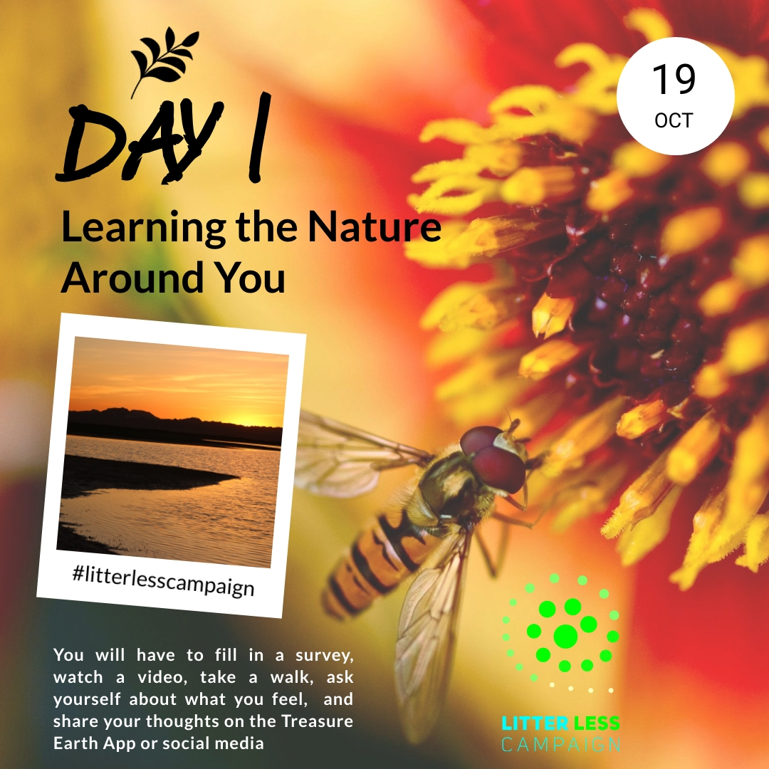
Learning about Nature Around You
Please fill-in our surveys on Pollution at the start and at the end of the campaign and receive a certificate from the Foundation for Environmental education
Take a moment to watch this video: Planet Earth: A Celebration - a message from Sir David Attenborough | BBC Earth - YouTube
Ask yourself, how do you feel as you watch the video?
Take a 10-minute walk anywhere outside. Take your time and engage each of your senses one by one. What do you see, smell, and hear? What is one thing you are thankful about what you just observed? Can you think of reasons why nature does not produce any waste?
Share your thoughts on FB/Twitter/ Instagram with the hashtag #litterlesscampaign and @ Eco-Schools England.

Slide 5
Caught in plastic
1) Together with a friend or family member, watch this short video about plastic pollution: https://youtu.be/IA9O9YUbQew
2) What emotions are you feeling as you watch the video? What emotions do you think an animal, such as a dolphin, turtle, or seabird experience if it swallows a bottle cap or is caught in a plastic bag?
3) What can we do to reduce the suffering of the animals? For some ideas, you can watch this video: https://www.youtube.com/watch?v=hKFV9IquMXA
4) Share your thoughts on FB/Twitter/ Instagram with the hashtag #litterlesscampaign and @ Eco-Schools England, make a commitment to reduce your use of plastic (For example: “I will try to avoid wrapping my lunch in a plastic bag”).

Slide 6
Invisible pollutants
Not all types of pollutants can be smelled or are visible to our eyes. We tend to use many products that contain chemicals that evaporate into the air or are washed into our sewage systems posing a risk to all living residents of the planet which includes us, humans, as well as animals, and plants.
1) Watch this video if you want to know more about invisible pollutants: How to claim your right for a life free from chemicals - YouTube.
2) Can you find five products in your home that contain toxins or chemicals that can be harmful for humans, animals, and plants? Which labels indicate that these products can be harmful? How do these chemicals find their way to nature?
3) Can you find or make alternative products that are less harmful? For inspiration, you can check out this video: https://youtu.be/ToHirl_a-es
4) Share your ideas of non-toxic products on FB/Twitter/ Instagram with the hashtag #litterlesscampaign and @ Eco-Schools England

Slide 7
Why do I need it?
1) Sit quietly and reflect on the things you or your family have bought the past two months. Any new clothes, electronic gadgets, decorations for your room, makeup? Why did you buy these? How long will they last? How long do you intend to keep them for?
2) Call your grandparents or a family friend over 70. Ask them what and how many things they bought when they were your age. Why do you think we are buying more things and producing more waste today?
3) We all need to carefully consider our consumption needs and habits to promote a circular rather than a linear, “buy-and-throw-away” culture. Learn the basics about Circular Economy here: https://youtu.be/zCRKvDyyHmI
4) Share your commitment to reduce consumption on FB/Twitter/ Instagram with the hashtag #litterlesscampaign and @ Eco-Schools England.

Slide 8
Zero-waste day
1) Take up the challenge of living a full day of your life without creating any waste that is disposed to a landfill or burned. You will surely find out that it is not an easy task! Nevertheless, this exercise will help you understand how human lifestyle was adapted to consume resources unsustainably, but at the same time how easily we can re-adapt our lives, so we get more out of the resources we consume while preserving nature.
You can use these five Rs to help you out:
Refuse what you don’t need such as plastics and ‘free stuff’
Reduce what you are purchasing (Including packaging)
Reuse and repair what you already have or buy 2nd -hand
Recycle any waste that really can’t help producing
Rot any organic waste you produce in a compost bin
2) Count the number of actions you have taken to reduce waste pollution during the day (based on the 5 Rs)
3) Take photos or create short videos (up to 1-minute) of your Zero-Waste Day efforts and share on FB/ Twitter/ Instagram with the hashtag #litterlesscampaign and @ Eco-Schools England
This action in the form of video can be presented for the competition. See more details above.

Slide 9
A joint effort
1) We are not powerless, and we have the ability to contribute to our world by changing ourselves. Imagine a scenario where you see someone littering or using products that pollute the environment. Discuss with your friends and family on what you can do to encourage the person to prefer sustainable products or make effort to dispose responsibly. Will you approach the person by yourself, involve adults or the local municipality?
2) Share your thoughts using the Treasure Earth app (Under Litter-less campaign or Community) or on FB/Instagram with the hashtag #litterlesscampaign.
3) Fill-in our second survey on Pollution before the last action and receive a certificate from the Foundation for Environmental education.
Once you completed the short survey, download your #LitterLessCampaign Certifcate

Slide 10
Celebrate the clean environment with a litter-pick-picnic
1) Choose a time for a litter-pick-picnic with your family or friends. Pack a blanket, some food and drinks in reusable container, as well as gloves/litter-pickers, bags, and hand sanitizer. Walk together to a nice green area of your choice. On your way there, pick up the litter that you might see on the street or path.
2) Once you arrive, take 10 minutes to pick up any litter in the surrounding area – even the small cigarette butts!
3) Celebrate your efforts by enjoying the clean nature together and the food you brought. Take a photo of your celebration and of the litter picked and share on FB/Twitter/ Instagram with the hashtag #litterlesscampaign and @ Eco-Schools England.

Slide 11
The #LitterLess Competition
Based on the most challenging action which is the ’Zero-Waste Day’ (Action 5)
Participate = 1-minute videos
Share = on social media usinf #LitterLessCampaign
Submit = @ Eco-Schools England in your social media post(s)
Eco-Schools England will select the best 3 ’Zero-Waste’ entries for England
Selected entries must have registered on the Eco-Schools England website to take part in the Litter Less Campaign.
The best videos will be selected according to the age category
The best 10 global entries will be selected by the Eco-Schools International team
Prize of 100USD each, a certificate and mentionning in Eco-Schools international social media

Slide 12
The #LitterLess Competition
Criteria for acceptance
Time frame
The entry has to be in English (or translated).
The entry must be an example of a ’Zero-waste’ action.
Videos must be no longer than 1 minute
The entry has to be posted on at least one social media platform with the hashtag #litterlesscampaign AND @ Eco-Schools England.
Have registered to be part of the Litter Less Campaing on the Eco-Schools England website.
10 days for submitting the 3 best entries after the mini-LLC (Until the 12th of November)
Results at the beginning of December

Slide 13
THANK YOU!
Do you have any questions?

